Slide 1
hari tableau project
File created on: 09-10-2022 20:02:11

Slide 2
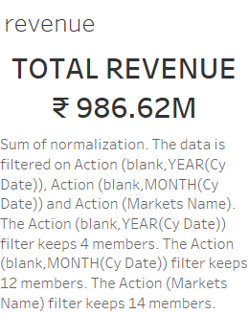

Slide 3
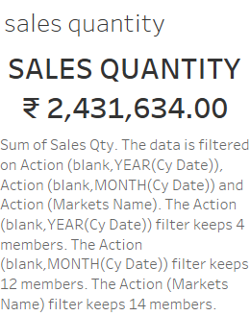

Slide 4
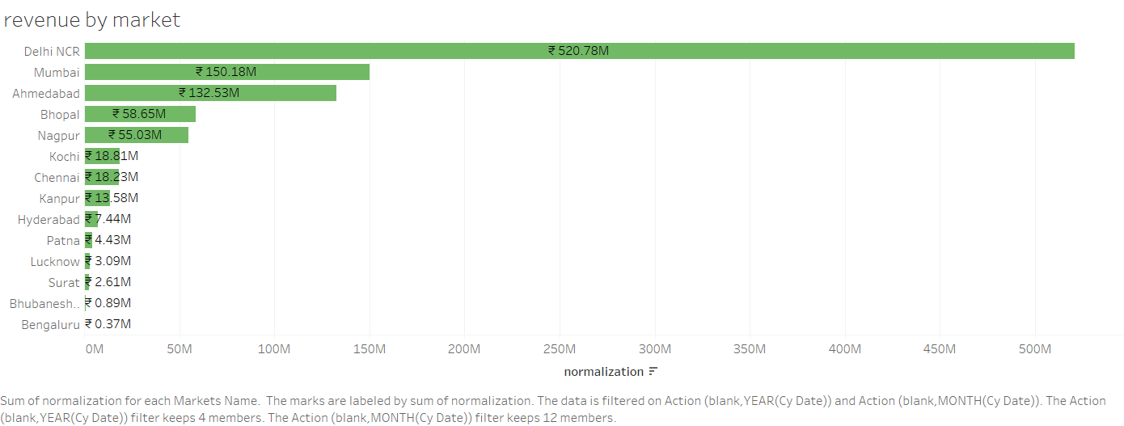

Slide 5
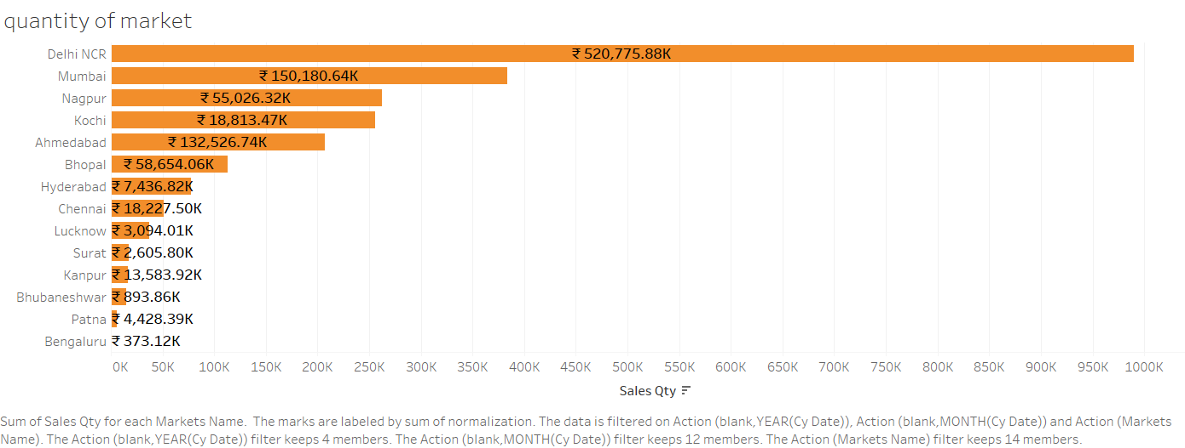

Slide 6


Slide 7


Slide 8
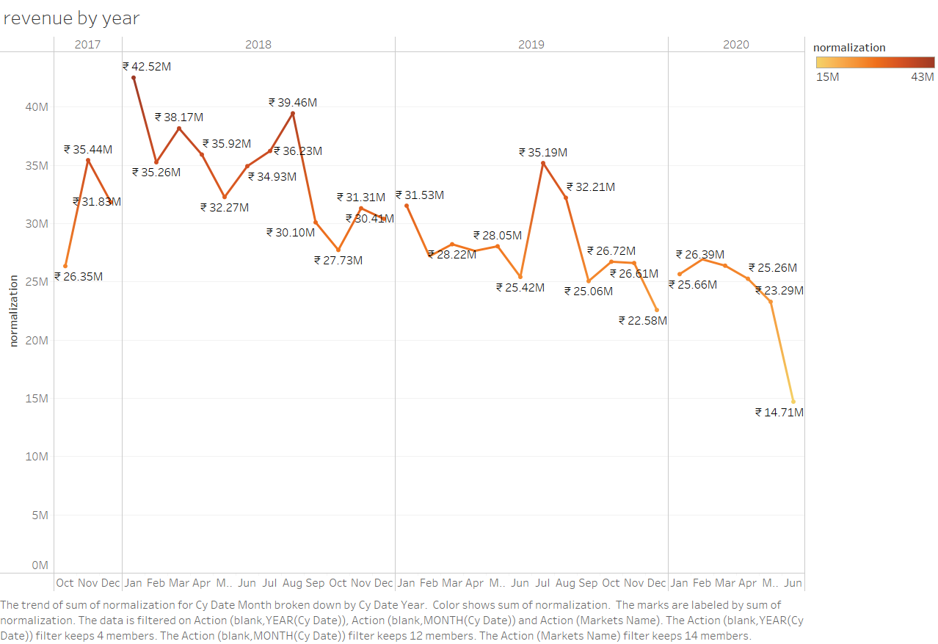

Slide 9
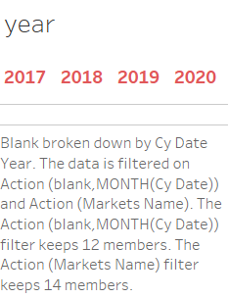

Slide 10


Slide 11
